Slide 1
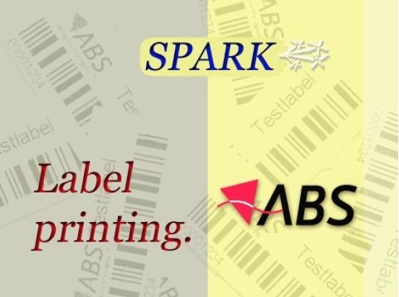

Spark Label Designer
Notes:
Customize for your customer: go to VIEW, SLIDE MASTER and replace on ALL slides in the SLIDE MASTER the logo… 2 minutes job …
NOTE: In this presentation lot of slides are HIDDEN since the presentation is used for an EXECUTIVE presentation to EXISTING customer.
The hidden slides can be un-hidden for presentations to new customers… in that case you need to decide what to hide from WHAT’s NEW and DEVELOPMENT ROAD MAP.

Slide 2
Topic’s
  General overview
  Technical basics
  Setup in ABSSolute
  Overview Spark Print and Spark Engine
  Define an initial Spark label
  Manage label printers and designs

Slide 3
General Overview (1)
What is Spark?
  Spark is a side product of ABS with a specific purpose; design and print labels. Labels are important in the laundry-realm and are mainly used to uniquely identify items like garments.
  To retrieve i.e. the owner of a garment, it’s necessary to use an identification-system like a label that is fixed to a garment. This label can all kinds of information like the name of the owner, the inset date, a barcode etc.
  Labels are also used to disclose the name and/or function of the wearer.

Slide 4
General Overview (2)
Designing labels
  The information to be printed on a label is customer specific. Spark gives you the freedom to design labels that meet your specific requirements or that from your customer!
  The contents can be fixed information (like a logo or a company name) complimented with information from a given set of fields coming from ABSSolute.
  It’s also possible to enter information manually, after which one or more labels can be generated, each with their own unique identification number.

Slide 5
General Overview (3)
Printing labels
  Independent of the designing function, a Spark component (Engine) takes care of generating a print job and submitting that to Windows.
  Every second the Spark Engine checks for the existence of a file, with print-commands, in a given location. If it finds one, it will be processed.
  For the actual printing the Windows-environment is used, which implies that you don’t have to wait until the labels have been printed. Another advantage is, that you can make use of network-printers; in that case the printer can be in a different location.

Slide 6
Technical basics (1)
Helicopter view of the label printing process
  In ABSSolute, a user (or process) requests for a label to be generated
  ABSSolute generates a file with all fields related to the garment in focus
  Spark Engine moves this file to it’s working memory for processing
  The appropriate design is loaded by the engine and combined with the information in memory for printing
  This print request is send to a Windows printer

Slide 7
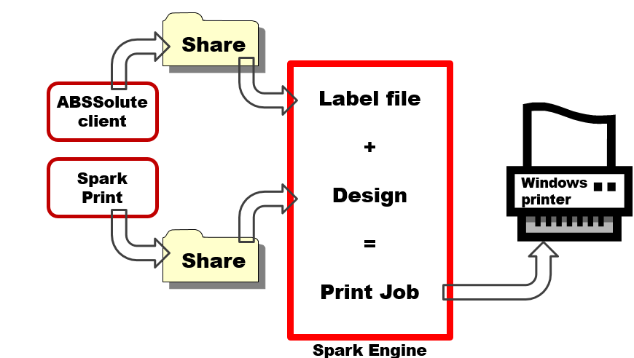
Technical basics (2)
Helicopter view of label printing process

Slide 8
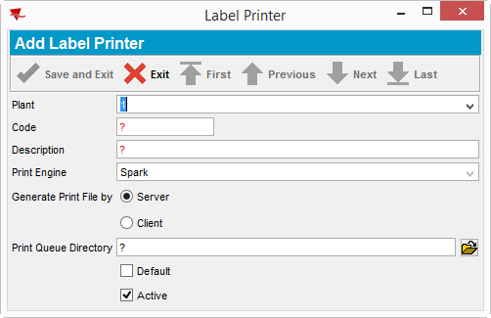
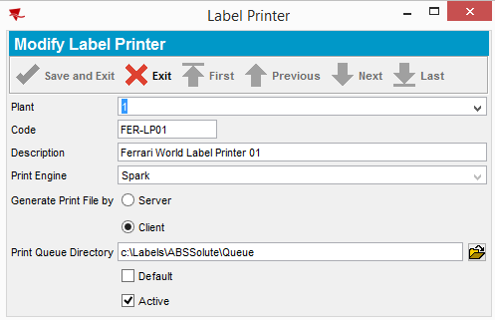
Setup in ABSSolute (1)
Label printer
  Define each label printer in ABSSolute in the dialogue “Label Printer”

Slide 9
Setup in ABSSolute (2)
Label layout (1)
                Define each label layout you have created with Spark Print in ABSSolute in the dialogue “Label Layouts”
    Points of attention
          Keep “Interface Code” equal as the Design in Spark
          Code Is a description so you know for what or who this label is used
          Label “Type”:
            Code = C
            Name = N
          Price field must be filled, but may be 0,00

Slide 10
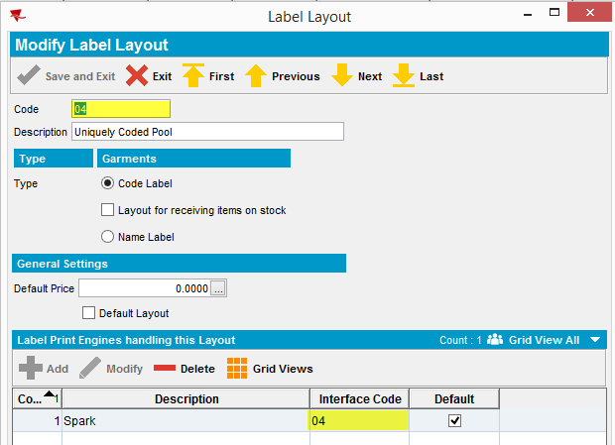
Setup in ABSSolute (3)
Label layout (2)

Slide 11

Setup in ABSSolute (4)
Workstation Setting (1)
  A label printer can be ‘connected’ to one or more workstations in ABSSolute.
  Select a workstation and click “Modify”
  Switch to tab “Label Printers”
  Click “Add”
  Select the appropriate label printer and click
  Click “Save and Exit” twice

Slide 12
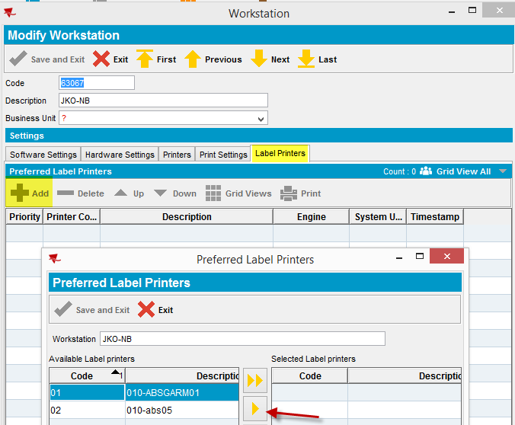
Setup in ABSSolute (5)
Workstation Setting (2)

Slide 13
Setup in ABSSolute (6)
Customers (1)
  The label layout created earlier can be used for one or more customers (from the “Customers” dialogue)
  Select the required customer and click “Modify”
  Switch to tab “Garments”
  Select the appropriate label layout and click “Save and Exit”

Slide 14
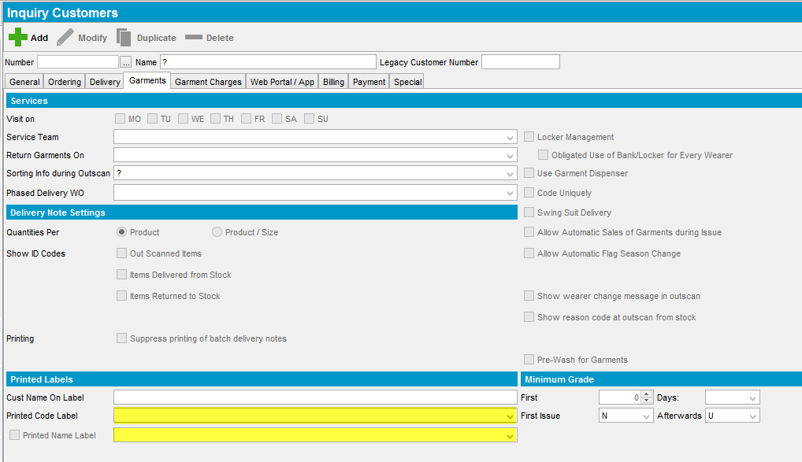
Setup in ABSSolute (7)
Customers (2)

Slide 15
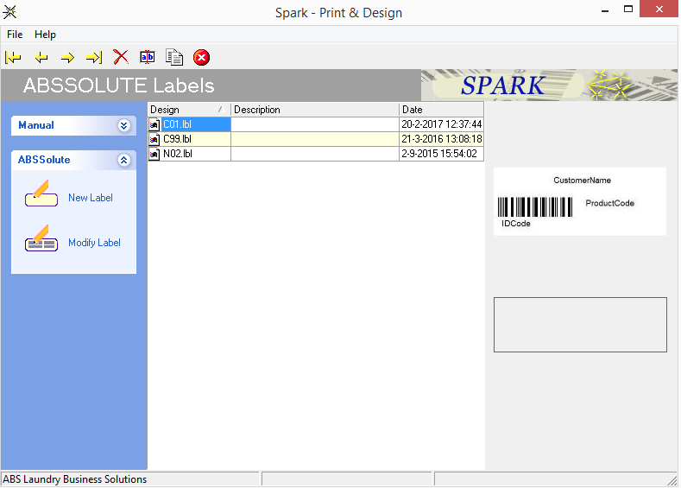
Overview Spark Print and Spark Engine (1)
Spark Print (1)

Slide 16
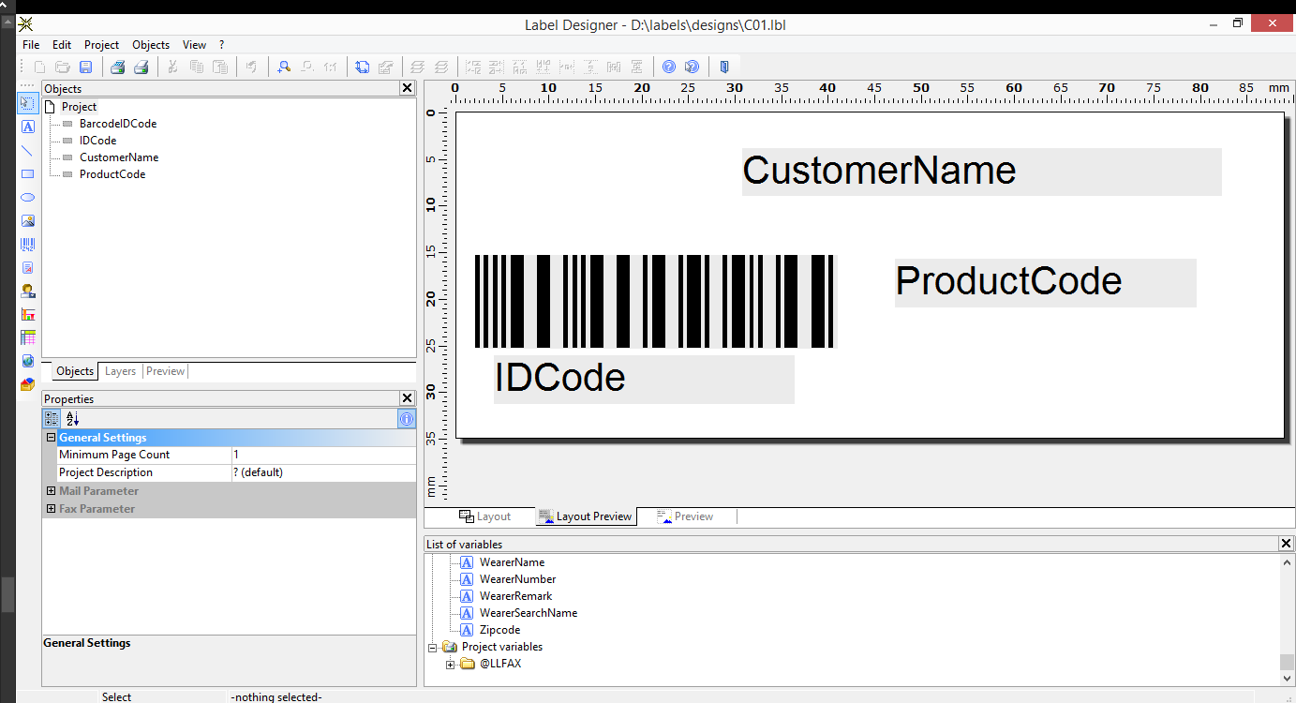
Overview Spark Print and Spark Engine (2)
Spark Print (2)

Slide 17
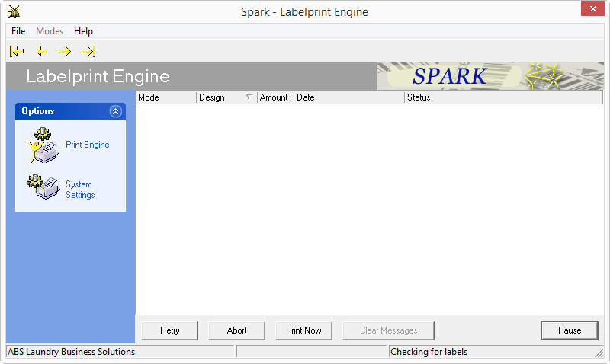
Overview Spark Print and Spark Engine (3)
Spark Engine (1)

Slide 18
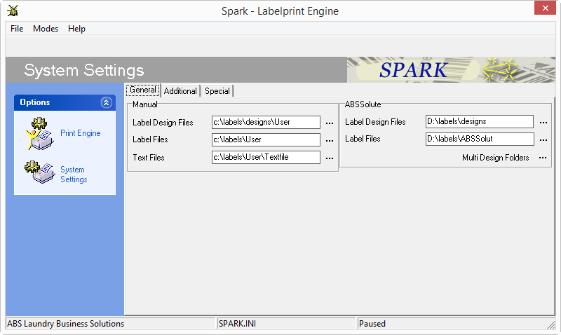
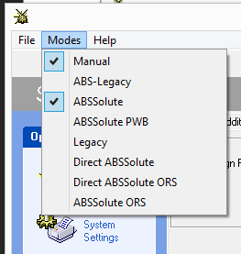
Initial Spark LabelOverview Spark Print and Spark Engine (4)
Spark Engine (2)

Slide 19
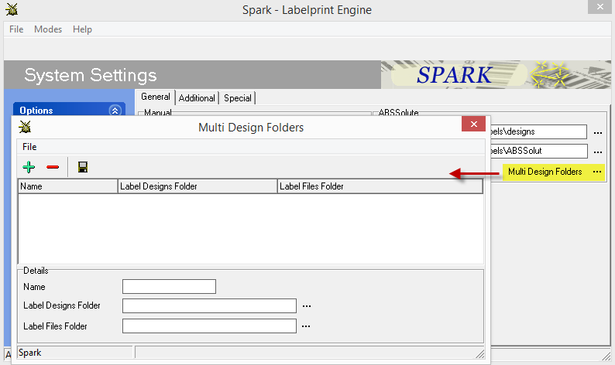
Manage label printers and design (1)
Spark Engine (1)

Slide 20
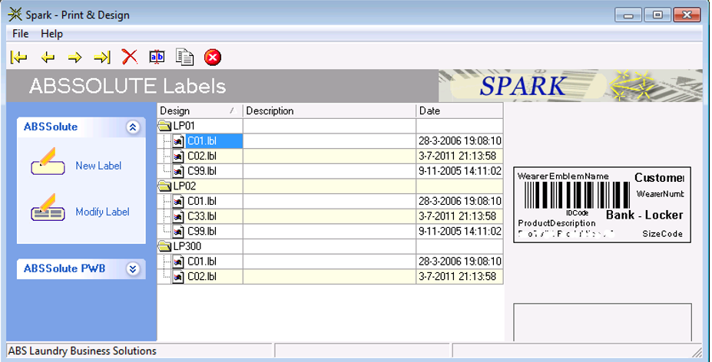
Manage label printers and design (2)
Spark Print (1)

