Slide 1
GENERAL SYSTEM SET-UP
General user interface features
General structures
Plant structure
User profile
Menu structure
Workstation
General fixed files
Product structure
Product hierarchy
Product characteristics
Size definition

Slide 2
Plant structure
Plant
Business Unit
Depot
Legal Entity
Stockroom
Plant Department

Slide 3
User Profile
Plant
Single Task
Full Task
User Groups
Business Unit
Users
Employees
Employee Functions
Login credentials (username + password)
Language
System administrator Y/N
Authorizations

Slide 4
Menu Structure
Plant
Menu
User Groups
Work spot
Users
Dialog
Full Task vs Single Task
Visible Y/N
Read only Y/N
Foreign descriptions

Slide 5
Workstation
Plant
Business Unit
Workstation
Plant Department
Peripherals
Scanners / Readers
Document Printers
Label Printers

Slide 6

Product Structure
Activity
Plant
Turnover Groups
Product Group
Plant Department
Tax Group
Product
Weighing Category
Size Type
Modification Groups
Size Definition
Product Sizes
Finishing Methods
Modifications
Size Group

Slide 7
Product Characteristics
Product
Type Of Merchandize
Registration Unit
Color
Treatment scheme
Exchange Method
Fabric
Image
Soil Count Method
Washing Process
Catalogues
Tax Group
Finishing Code
Pack / Pack Content

Slide 8
Size Definition
Size Type
Product
Size Definition
Product Sizes
Width / Length
Unfinished length (optional)
Reference to unfinished length (optional)
Alternative Sizes (optional)
Emblem Size
Foreign descriptions
Size Group
(optional)

Slide 9
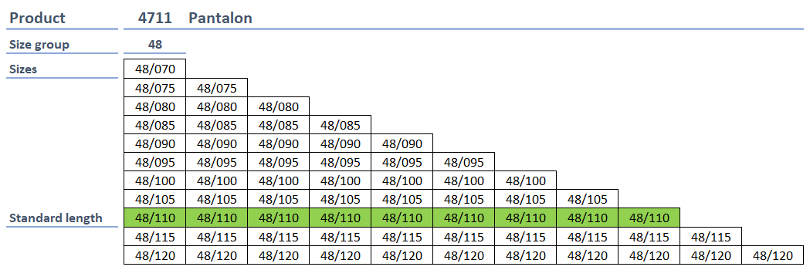
Product / size definition (I)
Alternative size logic with standard length (for reservation purposes)
Size
Size group
Standard length per size group (see green line: as ordered at suppliers)
Shorter sizes based on hemming (always used inventory)
Sizes exceeding the standard length size are Make-To-Order size
Reservation: system always tries to find exact match first

Slide 10
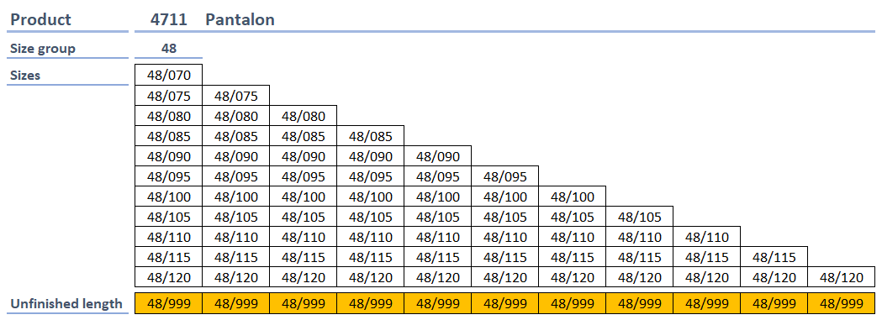
Product / size definition (II)
Alternative size logic with unfinished length (for reservation purposes)
Size
(Size group)
Unfinished size definition per size
Reservation: system always tries to find exact match first

Slide 11
GENERAL CUSTOMER SET-UP
General customer structure / hierarchy
Customer access (by business unit / user group)
Default processing / invoicing business unit
Customer product structure
Activities per customer
Product groups per customer
Product list per customer
Weighing categories by customer
Customer price structure
Price list per customer ➔ General or customer specific
Discount list per customer ➔ General or customer specific

Slide 12
General Customer Structure
Master Account
Common Customer
Customer (Debtor)
Customer (Del to)
Pay By Customer
Department
Delivery Point
Cost Center
Consumption Point

Slide 13
Customer Access
Business Unit
Default for processing
Customer
Default for invoicing
Business Unit
Processing By
Activities Per Customer
Business Unit
Internal Processing By
Product Groups Per Customer
Business Unit
Invoicing By
Product List Per Customer
Weighing Categories per Customer

Slide 14
Customer Product Structure
Customer
Activities
Activities Per Customer
Product Groups
Product Groups Per Customer
Products
Product List Per Customer
Weighing Categories
Weighing Categories per Customer

Slide 15
Customer Price Structure
Price List Per Customer
Customer
Discount List Per Customer
Product List Per Customer
Weighing Categories per Customer
Price List
Discount List
Rent
Rent
Wash
Wash
Replacement
Replacement
Sales
Sales
Weighing
Weighing

Slide 16
PRICING / BILLING OPTIONS
Price management
Price color coding
General
Customer specific
Multiple prices
Price history
Price ratification (optional) ➔ “4 eyes principle”\
Billing methods
Billing methods 1 to 5
Billing methods per business line

Slide 17
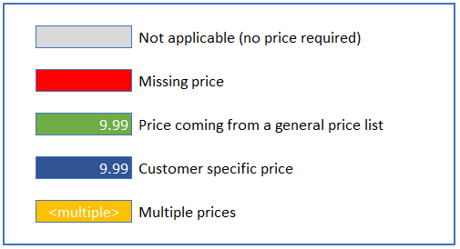
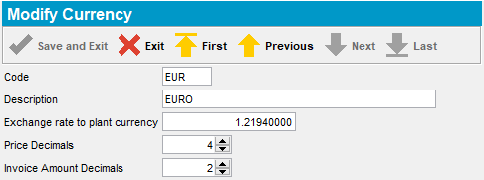
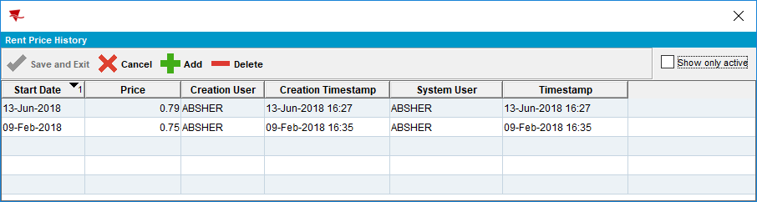
PRICE MANAGEMENT

Slide 18
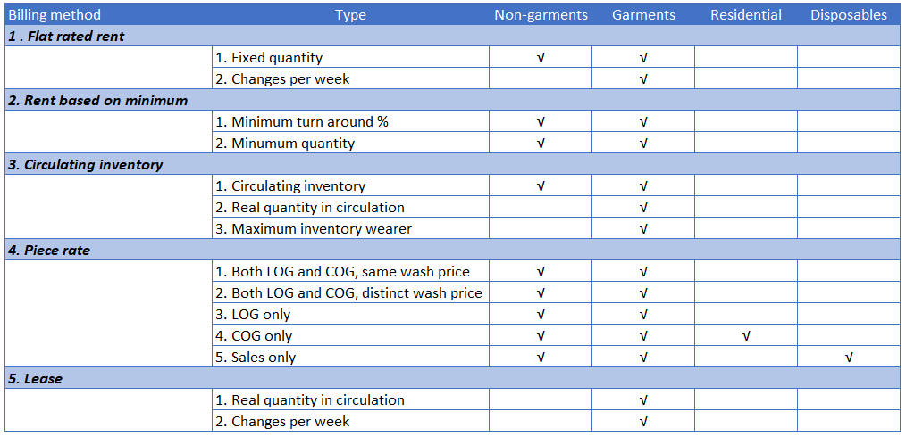
BILLING METHODS

Slide 19
ROUTE MANAGEMENT
Route structure
Routes / route planning per plant
Route structure in schematic view
Multiple routes per plant per day
Multiple route stops per route
Stop sequence
View stops on google maps
Route Status Control
Tracking of a route on a specific date
Relieve driver
Move route / move route stop
Permanent or temporary

Slide 20
Route Structure
Plant
Driving day (Monday – Sunday)
Route manager + District
Driver + Truck
Delivery Scheme (frequency)
Code on label
Packing day / deadline
Packing Documents (normal/reverse)
Start Time / End Time
Route
Depot
Route Stop
Delivery Point
Customer (Del To)
Stop Type (bring, get, mix, incidental)
Start date / end date
Travel Minutes
Service Minutes
Route List Instruction
Return Route
Contact Person

Slide 21
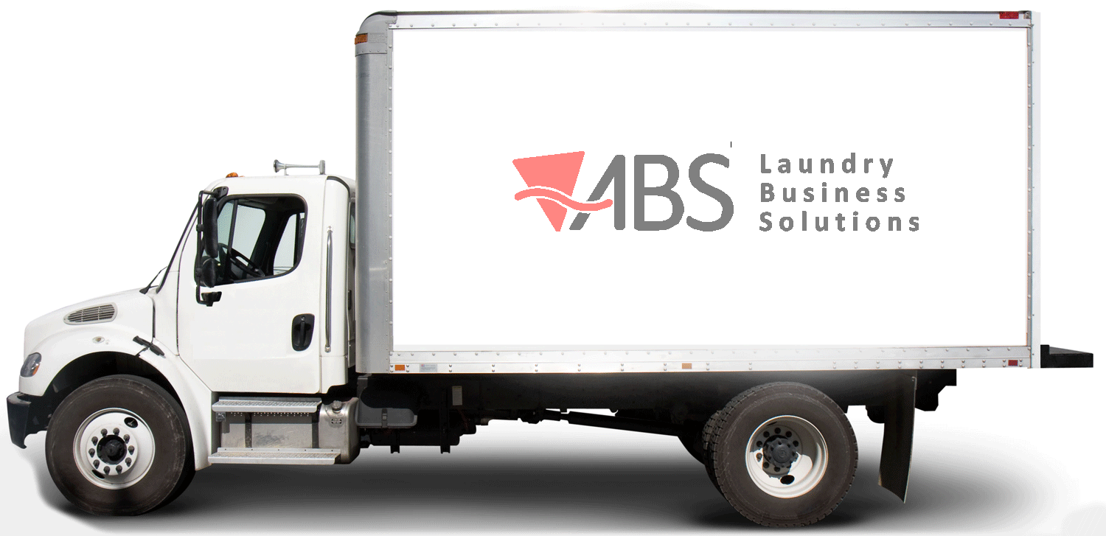
Route Structure
Plant
Depot
Route 100
Route 200
Customer
(Delivery)
Delivery Point
Stop 10
Stop 10
Delivery Point
Customer
(Delivery)
Customer
(Delivery)
Delivery Point
Stop 20
Stop 20
Delivery Point
Customer
(Delivery)
Customer
(Delivery)
Delivery Point
Stop 30
Stop 30
Delivery Point
Customer
(Delivery)
Customer
(Delivery)
Delivery Point
Stop 40
Stop 40
Delivery Point
Customer
(Delivery)

Slide 22
Move route / Move Stop
Route Planning / Structure: Permanent Move
Original Route
New Route
Original Route Stop
New Route Stop
End Date
Start Date
Route Status Control / Route Assistant: One Time Move
Original Route / Date
New Route / Date
Original Route Stop
New Route Stop
Canceled
To Visit (moved in)

Slide 23
BILLING METHODS

Slide 24
ROUTE MANAGEMENT
Route structure
Routes / route planning per plant
Route structure in schematic view
Multiple routes per plant per day
Multiple route stops per route
Stop sequence
View stops on google maps
Route Status Control
Tracking of a route on a specific date
Relieve driver
Move route / move route stop
Permanent or temporary

