Slide 1
ABS-159416 / ABS-163054
Wearer Inventory Control / Resetting Max Inventory

Slide 2
Concept
ABS-159416
  Control the quantity of garments in circulation - “Circ inventory control”
  Control the maximum number of garments - “Max inventory control”
ABS-163054
  Reset Maximum inventory to usage

Slide 3
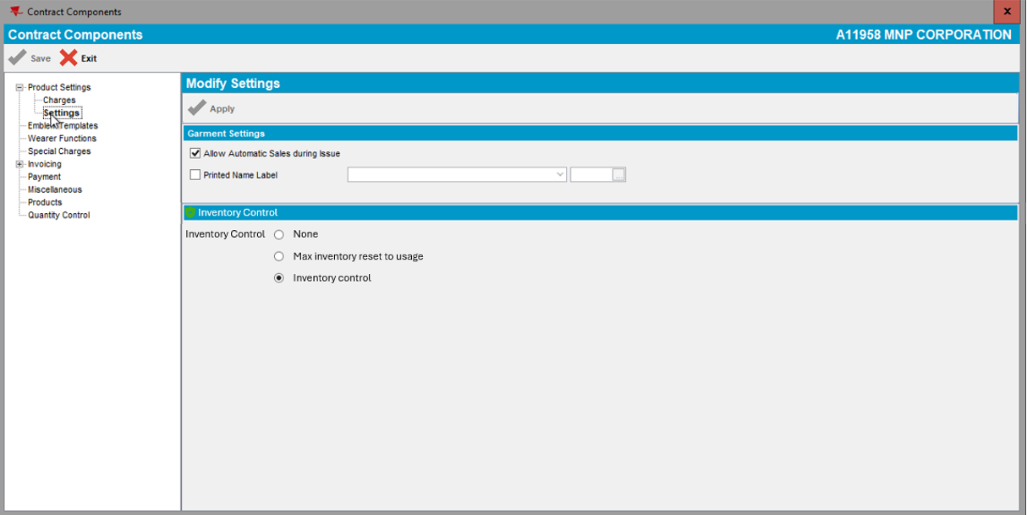
Concept
Mutually exclusive

Slide 4
Concept
Maximum Inventory Control in a little more detail
By product
Defined at contract and or customer level
Set a maximum inventory that the wearer is allowed to have
“Control Max”
Allow change of max in client / RA etc but never over this control value

Slide 5
Concept
Circulating Inventory Control in a little more detail
By product
Defined at contract and or customer level (noncontract customers included)
Set a percentage of maximum inventory that the wearer is allowed to have (rounded up)
“Control Circ percentage”
“Control Circ value”

Slide 6
Concept
Setting Maximum Inventory to Usage in a little more detail
Currently a Script
Where circulating inventory > max inventory
Customer is not inventory controlled
Is some other customer / contract level control needed?
Counts the number of unique items seen in the laundry in the last x days
  Adjusts Max to the usage
  Reduces circulating inventory to new max value if needed
What do we do with work orders in progress?

Slide 7
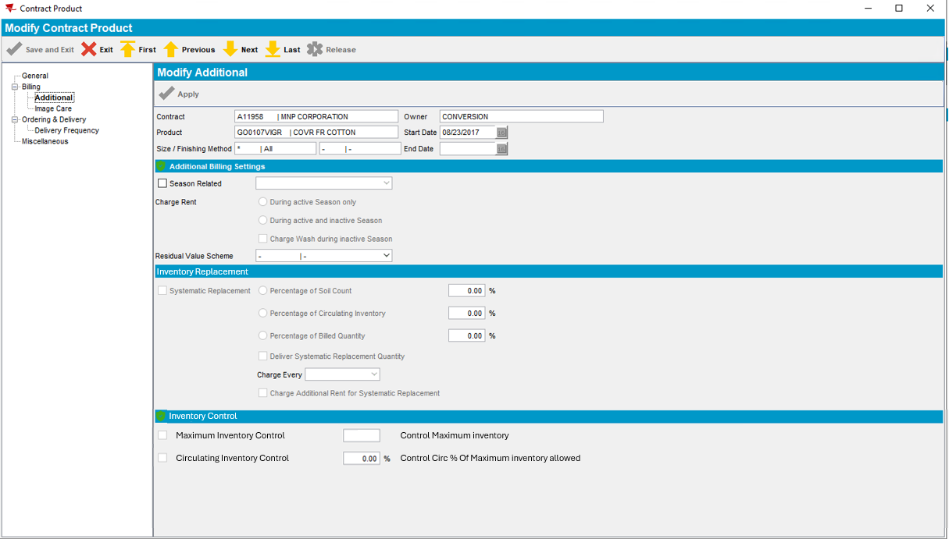
Design – Product level control
Contract Dialog
New control max and circ % fields against the contract product

Slide 8
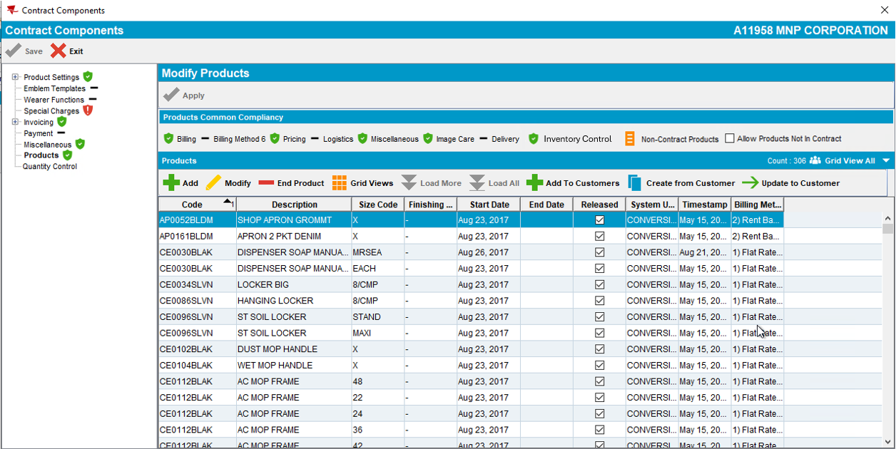
Design
Contract Dialog
New compliancy option

Slide 9
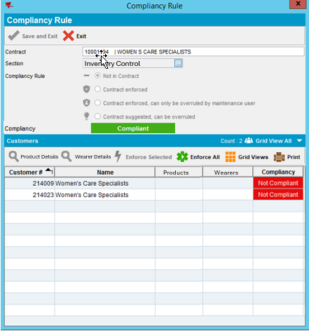
Design
Contract Dialog - Compliancy
New compliancy concept
Compliancy Dialog
2 levels
  Contract Product to PLPC
  PLPC to Wearer Inventory
Details
  Product compliancy (PLPC)
  Wearer compliancy

Slide 10
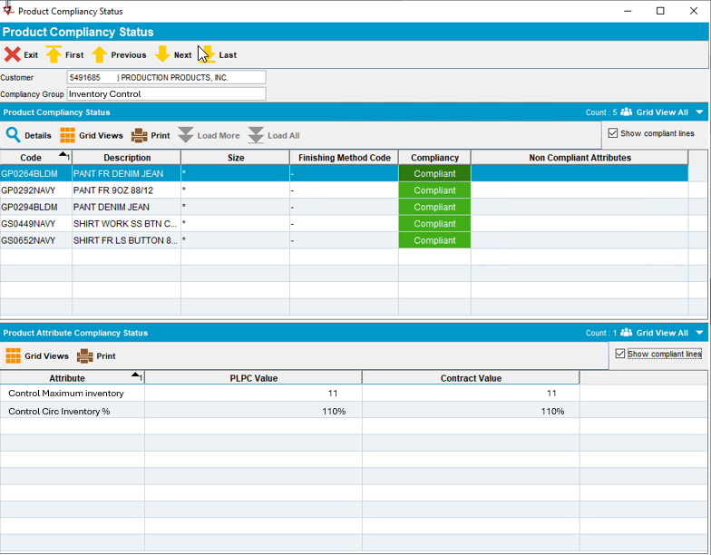
Design
Contract Dialog – PLPC Compliancy details
Standard form

Slide 11
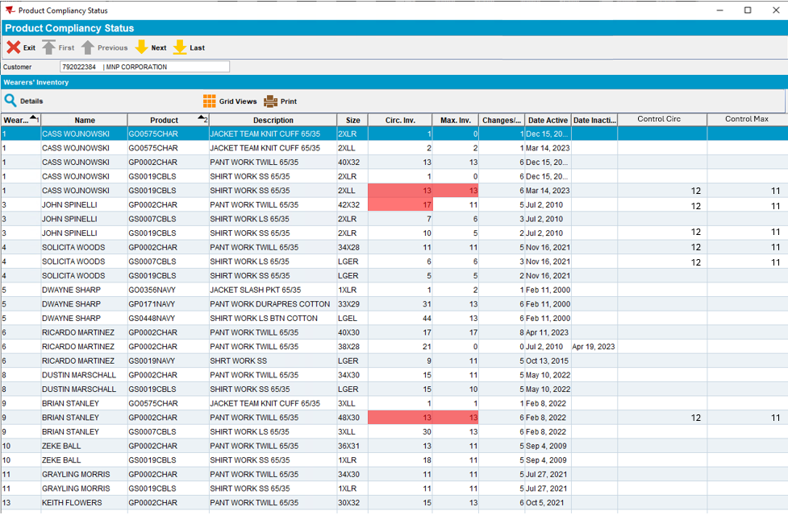
Design
Contract Dialog – Wearer Compliancy details
All wearer inventories that are controlled
Showing in red if too high
Details button to open the wearer inventory dialog

Slide 12
Design
Contract Dialog - Compliancy
New compliancy concept
Compliancy Dialog
2 levels
  Contract Product to PLPC
  PLPC to Wearer Inventory
Details
  Product compliancy (PLPC)
  Wearer compliancy
Enforce
  Sets PLPC values
  Reduces Max on wearers
  Reduces Circ where needed

Slide 13
Design
Compliancy Enforce
Update PLPC values from contract product – standard
Compare Wearer Inventory Max to PLPC level control Max
  Update Max on wearer inventories
Compare count of unique items (details to follow) with
Max Inventory * Control Circ percentage rounded up
  Rag garments to reduce circ to control value (details to follow)
Log in Wearer Inventory Movement table

Slide 14
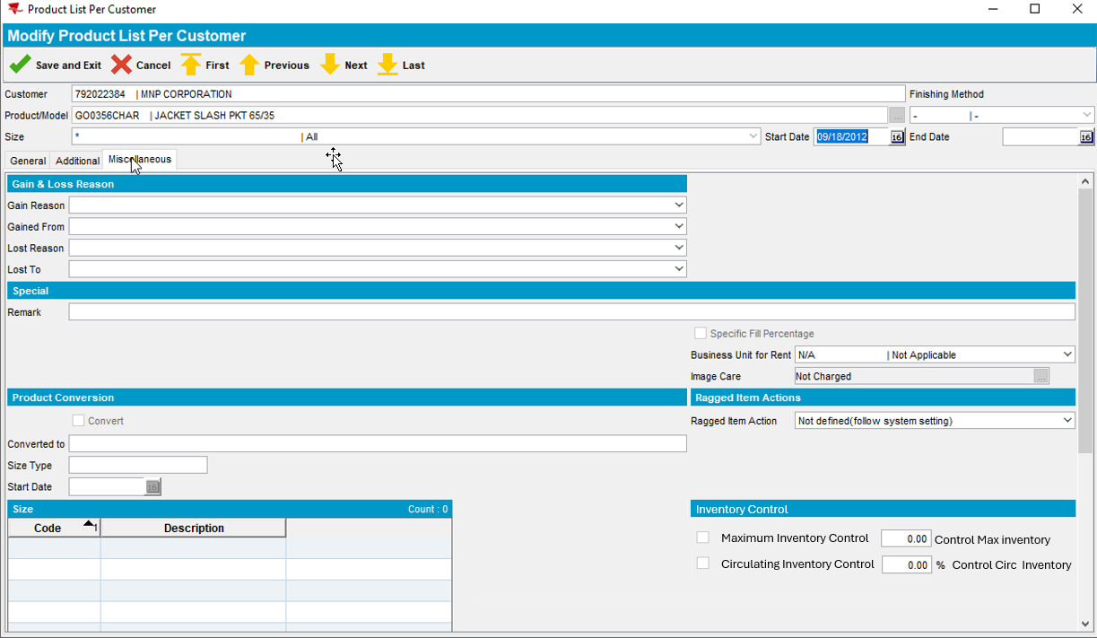
Design
ProductListPerCustomer
New Control Max and Circ fields against the product
Set from contract & compliancy controlled if the customer has a predefined contract

Slide 15
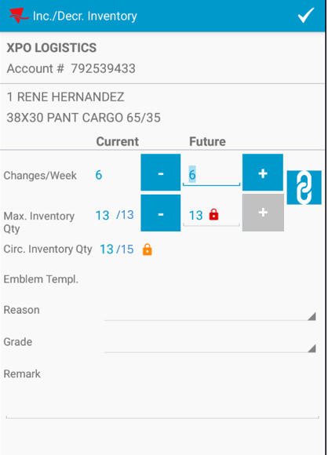
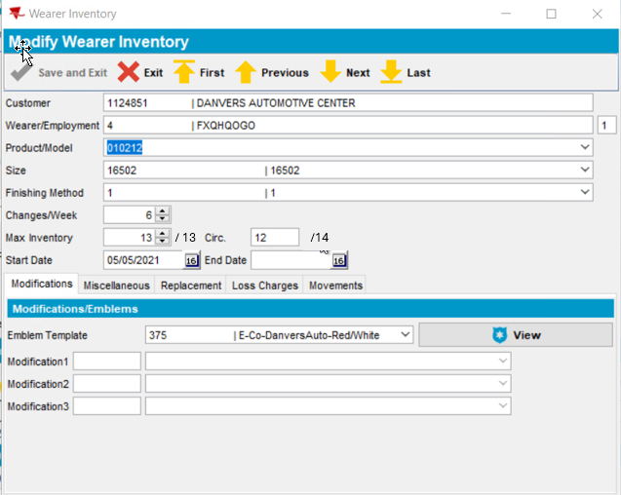
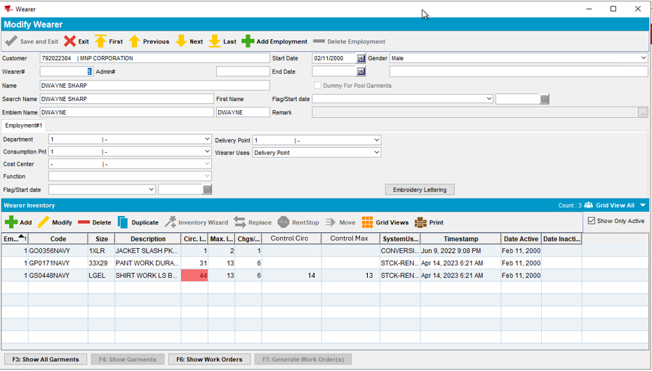
Design
WearerDlg
Show the control values
Inventory details
Block Max being set above control
Similar in the Route Assistant

Slide 16
Controls
Scheduled Process
There are many ways in the client of exceeding the controls
  Plant Loss
  Adding customer that already has wearers to a contract that has inventory control
  Changing control values on the contract product / PLPC
  Move wearers between customers
Scheduled process
  Brings wearer inventories inline with PLPC values
  Same logic (same process?) as contract compliancy enforce

Slide 17

Summary of areas to change
Fun starts here ☺
Contract
Contact Product
Contract Compliancy
Customer
PLPC
Wearer Dialog
Replace / Renewal dialog
Wearer Functions
Route Assistant
Route Check in
WebX Route Check in
Web Portal
Scheduled process
REST web service for wearers
ERP_I
Generate work orders

Slide 18
QUESTIONS?

